Slide 1


NEXT GEN EMPLOYABILITY PROGRAM
CREATING A FUTURE-READY WORKFORCE
Student Name :
Amulya H S
Student ID :
College Name :
STU65b7a7bf061c31706534847
PES University , Bangalore

Slide 2
CAPSTONE PROJECT SHOWCASE
Project Title
Notes Sharing Web Application using Django Framework (FSWD)
Abstract | Problem Statement | Project Overview | Proposed Solution | Technology Used | Modelling & Results | Conclusion | Q&A

Slide 3
Abstract
1
The project aims to develop a comprehensive Notes Sharing App tailored specifically for academicians, leveraging the powerful Django framework for web development.
2
This application seeks to address the challenges faced by academicians in accessing, organizing, and sharing educational materials and research resources efficiently.
3
By providing a centralized platform, the app will enable users to create, categorize, and share notes, papers, presentations, and other academic resources seamlessly.
4
This project also aims to revolutionize academic knowledge sharing, fostering collaboration, innovation, and advancement in research and education.

Slide 4


Problem Statement
Develop a web application that facilitates the sharing and collaborative
editing of notes among users.
The application should be built using the Django framework, adhering to
modern web development standards and best practices.

Slide 5

Project Overview
Project Name: Notes Sharing Web Application
Framework: Django (FSWD - Full Stack Web Development)
Objective: Develop a collaborative platform for users to create, edit, and share notes securely.
Key Features:
User authentication and authorization
Note creation, editing, and deletion
Real-time collaborative editing
Sharing notes with granular permissions

Slide 6
Proposed Solution
User Authentication and Authorization: Implement Django's built-in authentication system for user registration, login, and session management. Utilize Django's permission system to control access to notes based on user roles and permissions.
Note Management: Develop CRUD (Create, Read, Update, Delete) functionalities for notes using Django's ModelForms and class-based views.
Sharing and Permissions: Develop a permission management system allowing users to share notes with specific individuals or groups. Implement granular permission settings for each shared note (e.g., view-only, edit, download only).
Responsive Design: Utilize HTML5, CSS3, and JavaScript frameworks like Bootstrap or Materialize to ensure a responsive and mobile-friendly user interface.

Slide 7
Technology used
Django Framework: Django is a high-level Python web framework that encourages rapid development and clean, pragmatic design. It provides built-in features for authentication, database management, URL routing, and template rendering, making it suitable for building complex web applications efficiently.
Security Measures (e.g., HTTPS encryption, CSRF protection): Implementing security measures such as HTTPS encryption, Cross-Site Request Forgery (CSRF) protection, and secure session management enhances the security of the application and protects user data from unauthorized access or attacks.
Frontend Frameworks (e.g., Bootstrap, Materialize): Frontend frameworks like Bootstrap or Materialize provide pre-designed UI components and responsive layouts, making it easier to create a visually appealing and mobile-friendly user interface. These frameworks help ensure consistency across different devices and browsers.

Slide 8
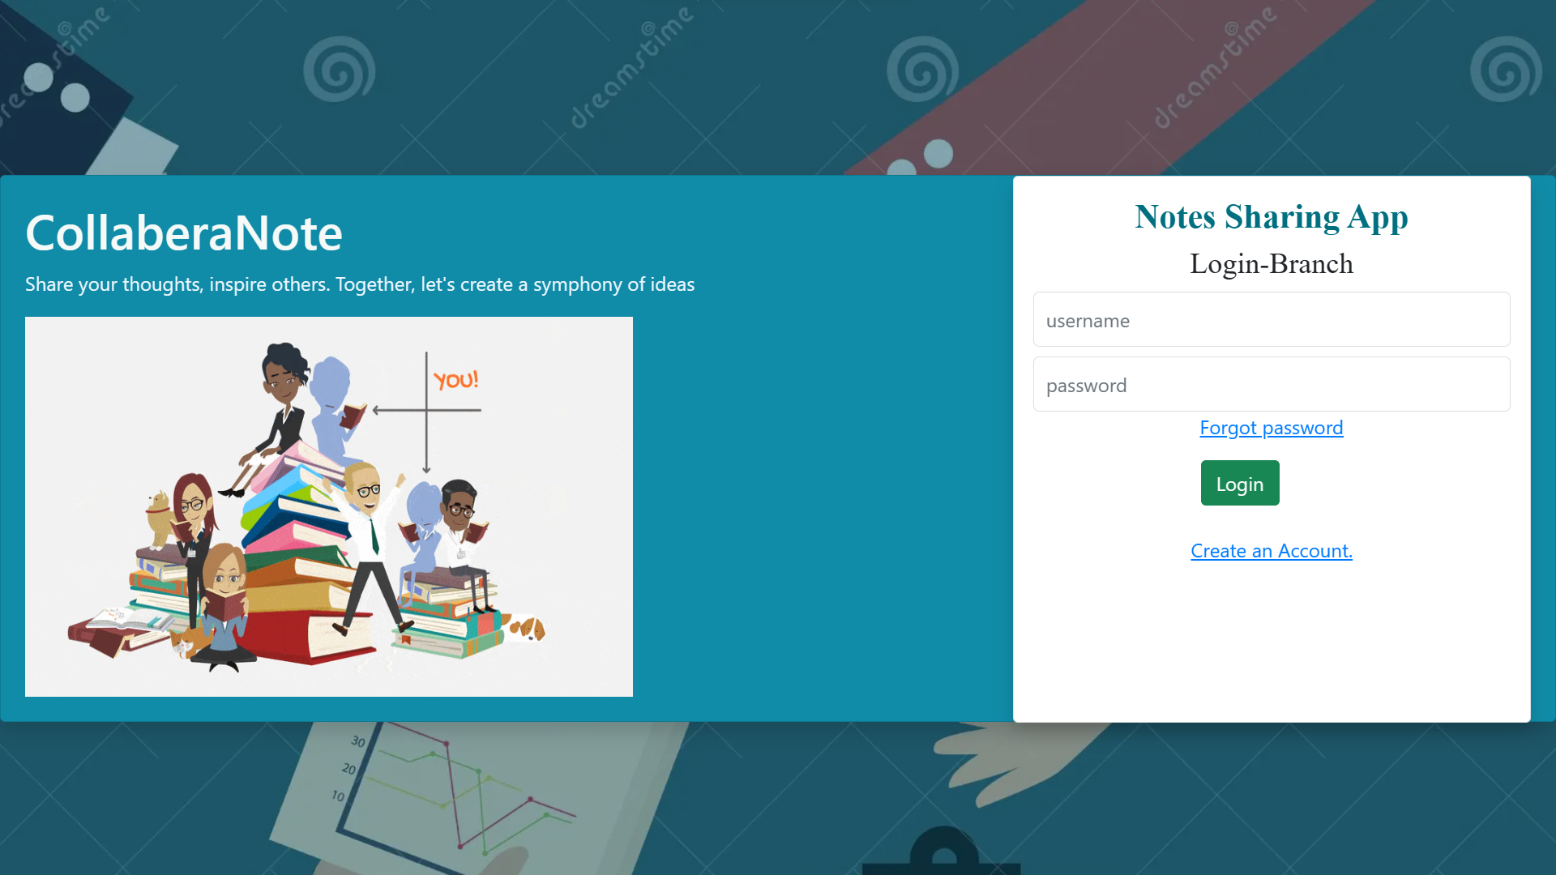
Modelling & Result

Slide 9
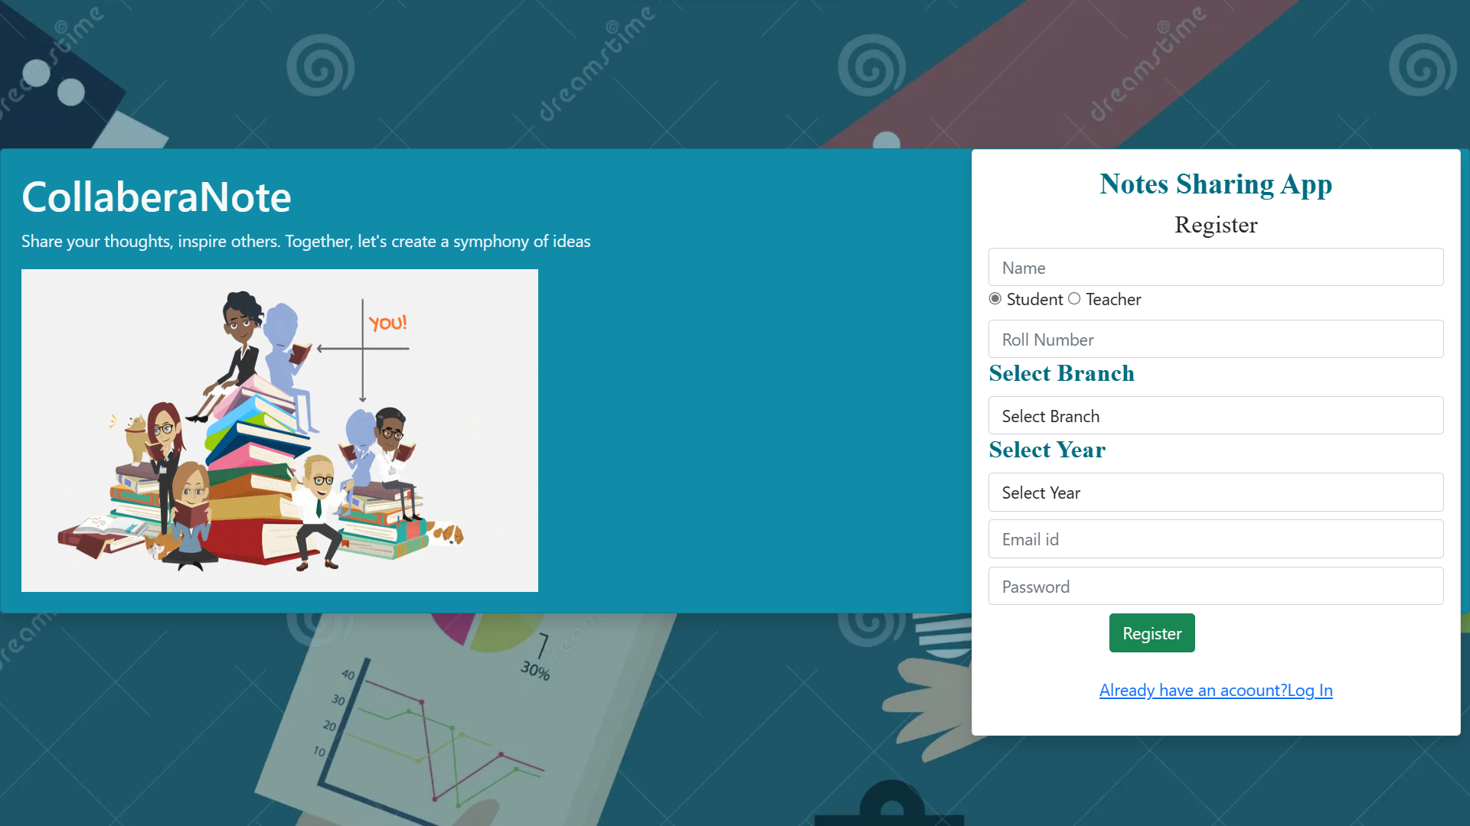
Modelling & Result

Slide 10
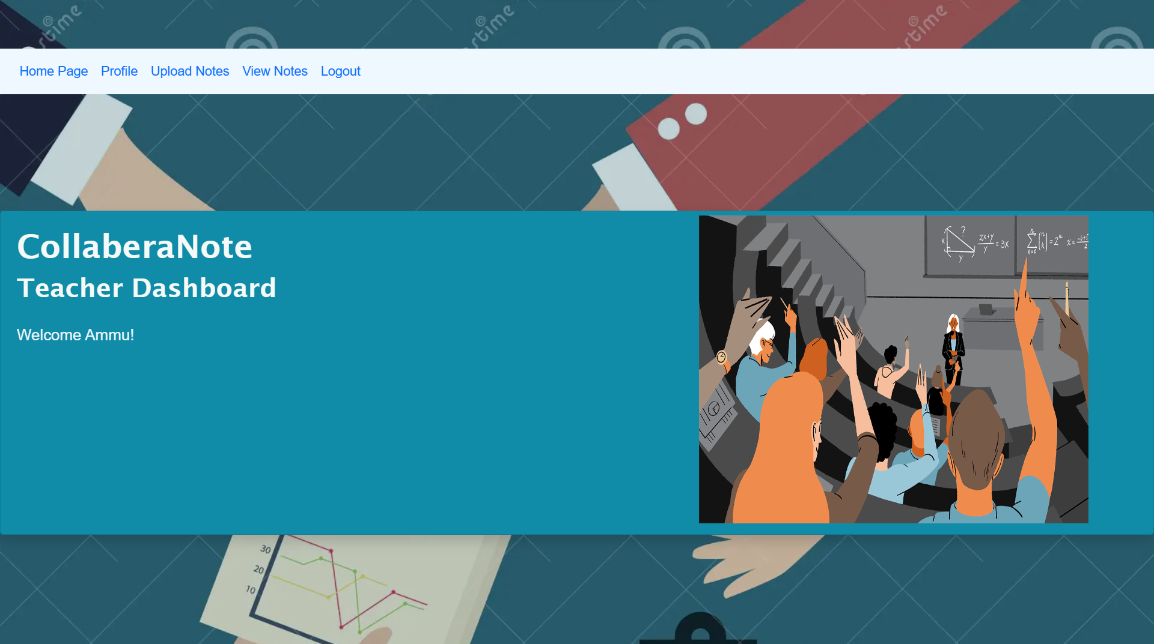
Modelling & Result

Slide 11
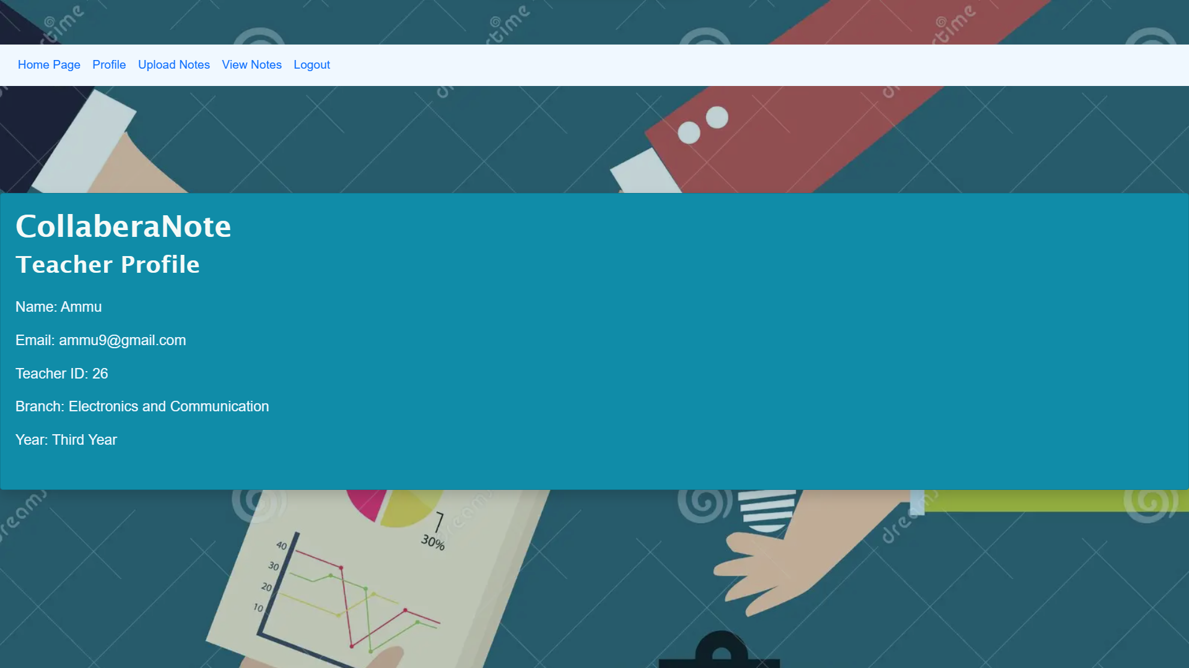
Modelling & Result

Slide 12
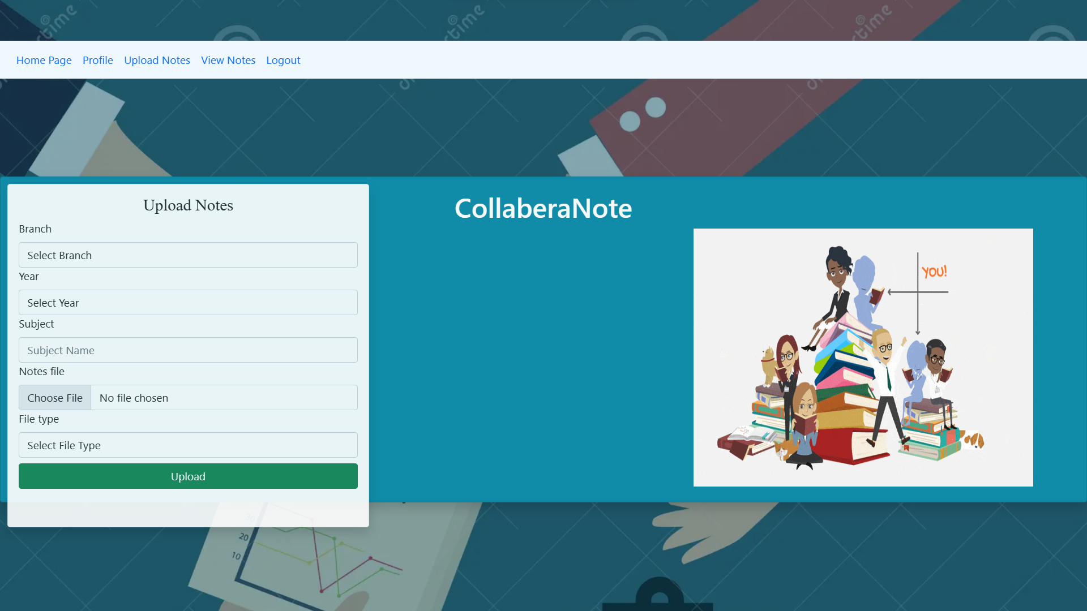
Modelling & Result

Slide 13
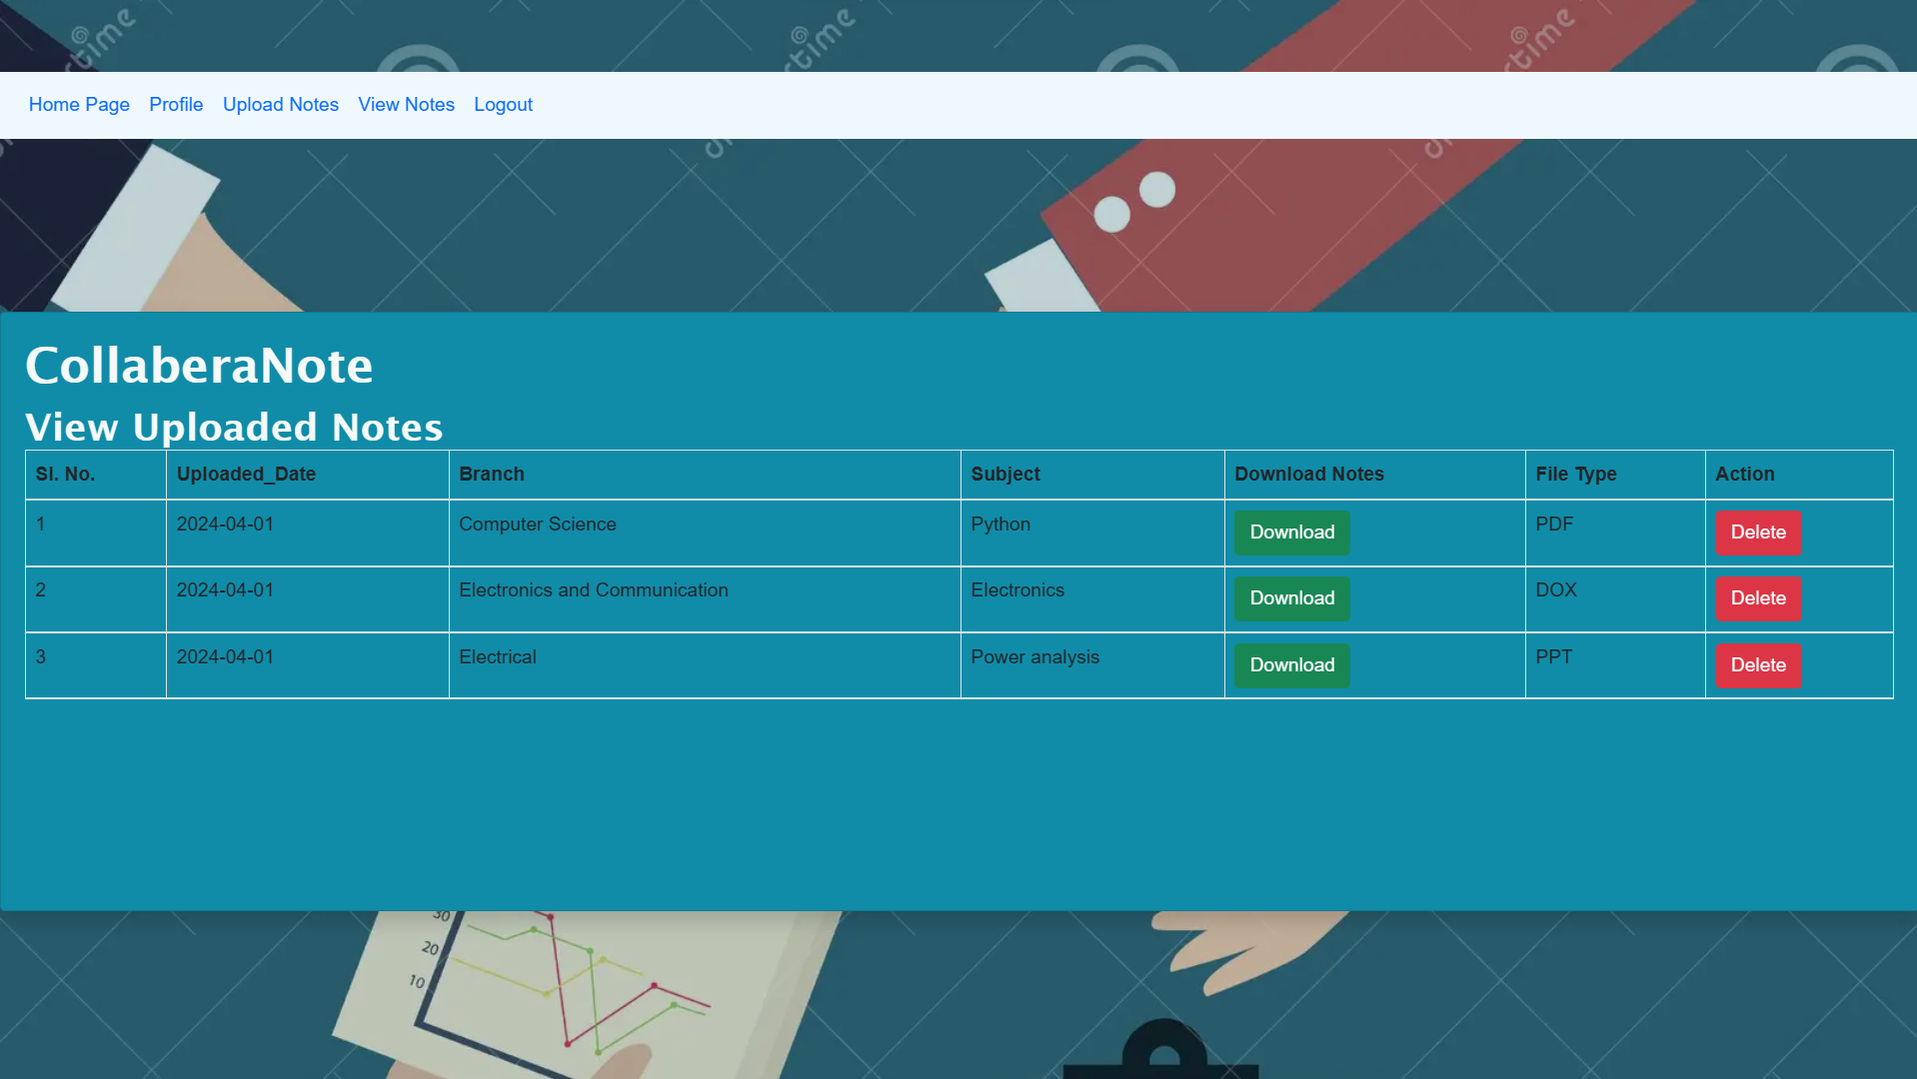
Modelling & Result

Slide 14
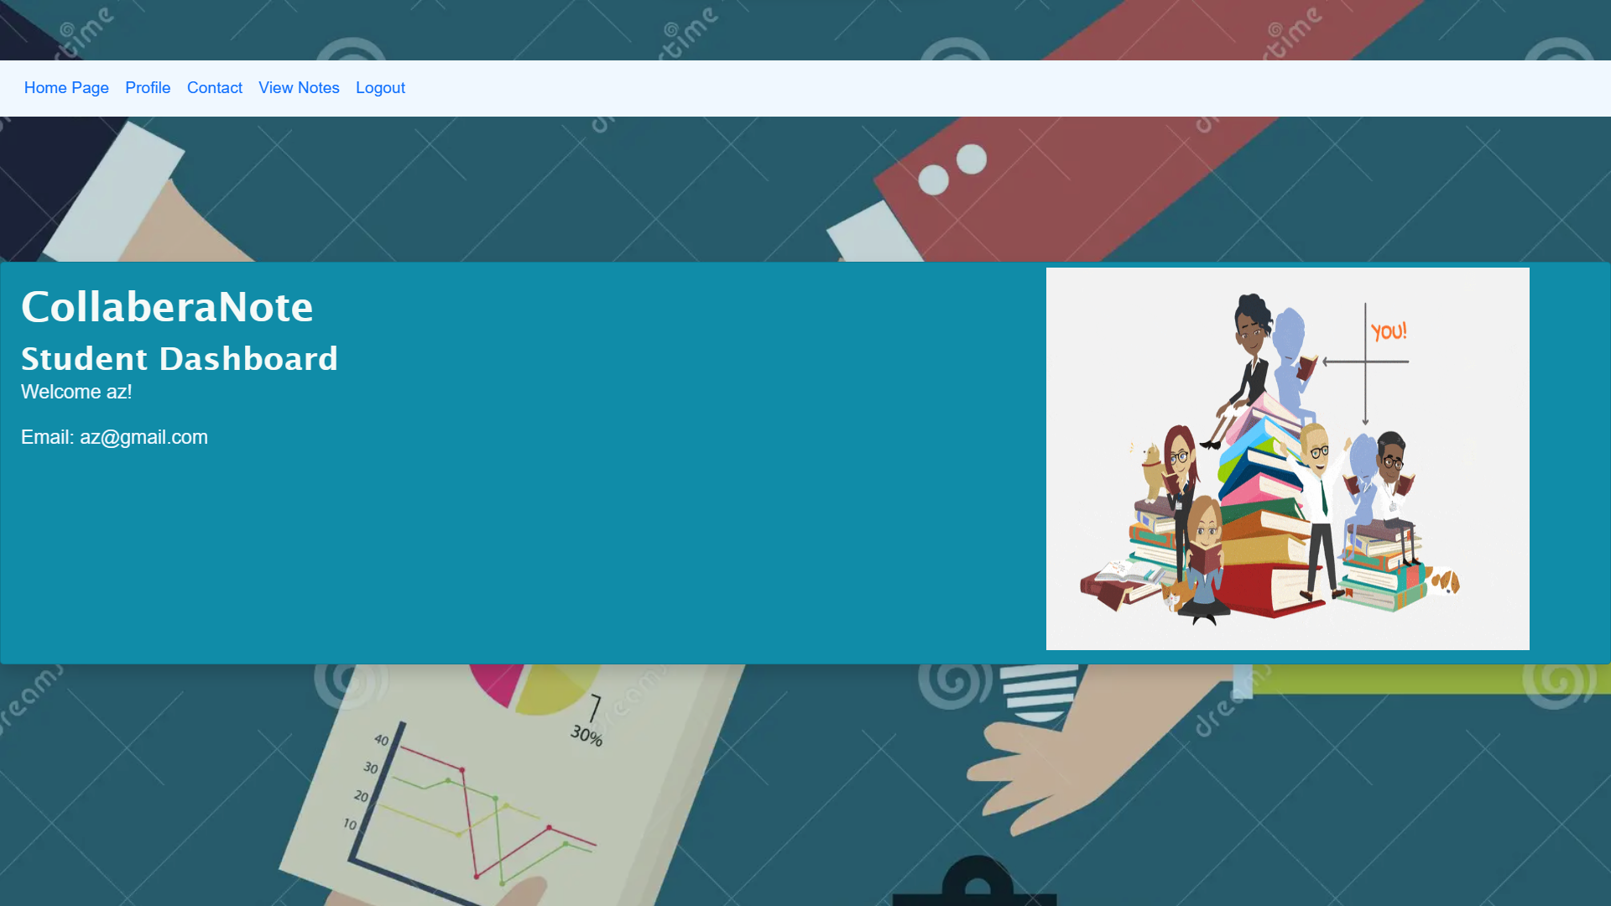
Modelling & Result

Slide 15
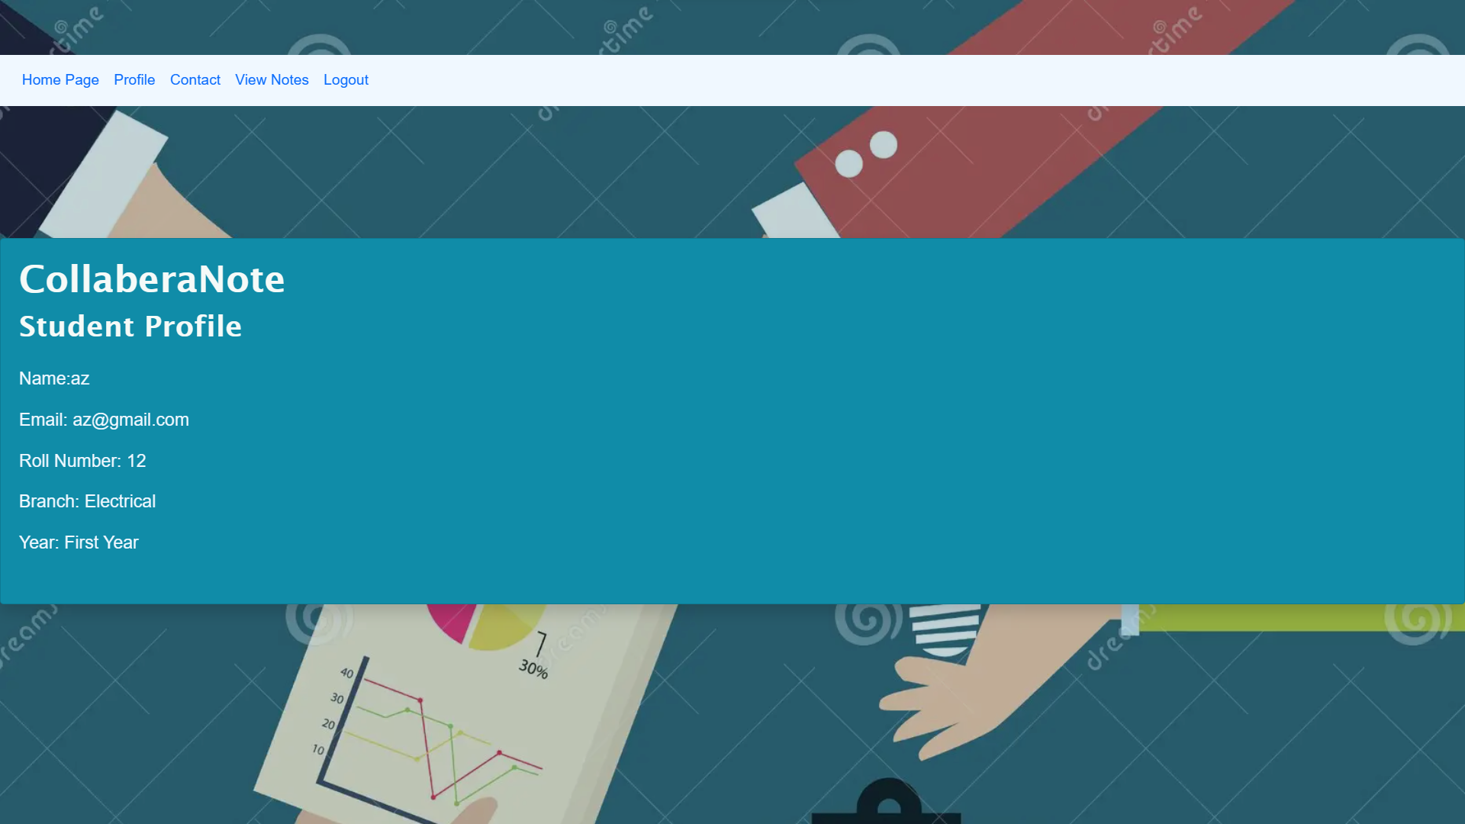
Modelling & Result

Slide 16
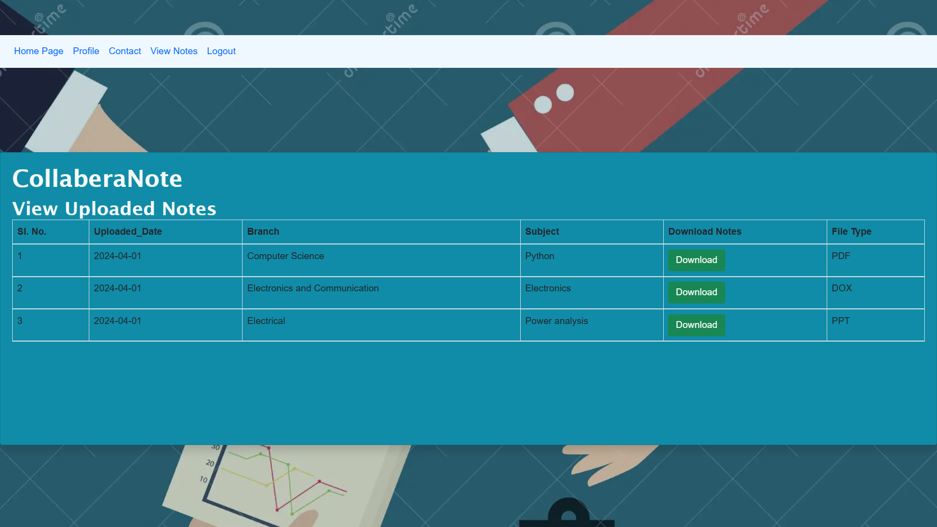
Modelling & Result

Slide 17

Conclusion
The proposed Notes Sharing Web Application presents a comprehensive solution to facilitate collaborative note-taking and sharing among users. By leveraging a combination of technologies including the Django framework, frontend frameworks, and security measures, the application aims to deliver a robust, secure, and user-friendly platform.

Slide 18


Notes:
Thank You !!

